Slide 1
LPG GAS LEAKAGE DETECTION SYSTEM WITH AUTO CUT OFF REGULATOR USING ARDUINO
CHARAN SHIV SPS (312421104302)
KIRAN KUMAR S (312421104089)
Dr. ADLIN SHEEBA M.E.,PH.D.
[GUIDE]

Slide 2
INTRODUCTION
LPG (Liquefied Petroleum Gas) is widely used in homes and industries, but leakage poses serious risks of fire and explosions. Without timely detection, gas accumulation can lead to fatal accidents.
This project presents an Arduino-based LPG gas leakage detection system with an automatic shut-off regulator to prevent gas-related accidents.
The system uses an MQ-2 gas sensor to detect leaks and immediately activates a solenoid valve to cut off the gas supply, along with an alert system for quick response.
This research provides a cost-effective and efficient safety solution to enhance gas leak prevention in homes and industries, ensuring a safer environment.

Slide 3
PROBLEM STATEMENT
LPG gas leakage poses serious risks, including fire hazards, explosions, and
health issues due to inhalation.
Traditional gas detection methods rely on human intervention, making them unreliable in emergencies.
Delayed detection and response can lead to severe property damage and life threatening situations.
There is a critical need for an automated LPG Gas Leakage Detection System that can detect gas leaks in real-time, trigger alerts, and automatically shut off the gas supply to prevent accidents.

Slide 4
MOTIVATION AND OBJECTIVES
MOTIVATION:
Address the risks associated with LPG gas leakage, which can lead to fire hazards, explosions, and health issues.
Provide an intelligent and automated solution to enhance safety in households and industries.
Improve response time by integrating IoT-based alerts for timely action.
OBJECTIVES:
Design and develop an Arduino-based LPG gas leakage detection system using an MQ-2 gas sensor
Implement an auto cut-off regulator to shut down the gas supply upon leakage detection.
Optimize the response time for gas detection and shutdown, ensuring real-time protection.

Slide 5
ABSTRACT
This study offers an Arduino-based LPG gas leakage detection system with an automatic shut-off regulator to offset gas leak-related accidents.
The system leverages an MQ-2 gas sensor to sense leaks and automatically activates a solenoid valve to close gas flow.
A system like this is well needed because detecting LPG leaks that are flammable is often very challenging, which can easily lead to the damage of property or physical harm to individuals.
The research identifies a cost-effective and reliable solution to maximize gas safety in domestic and industrial application.

Slide 6
LITERATURE SURVEY
S.no | Year | Authors | Journal | Title | Description | Advantage | Disadvantage / Research gap identified
1 | 2021 | Ashwini D.S, | International | Smart | It integrates | The system | The system relies on a stable
 |  | Rohith Naidu | Journal of | LPG Gas | sensors with an | provides real- | internet connection and sensor
 |  |  | Engineering Research & | Level Detection | IoT platform to | time | accuracy, which may degrade
 |  |  | Technology | and | enhance safety in | monitoring, | over time. High implementation
 |  |  |  | Safety System | residential and | remote | costs may limit its adoption in
 |  |  |  | using IoT | industrial settings. | access via | small-scale applications.
 |  |  |  |  |  | mobile
 |  |  |  |  |  | notifications and
 |  |  |  |  |  | leakage prevention
2 | 2015 | Ankit Sood, | International Journal of | Microcontroller | It sends SMS | The system offers | The system depends on GSM be
 |  | Bablu Sonkar, | Electrical and Electronics | Based LPG Gas | alerts when | remote alerts | network availability, which may not
 |  | Ameer Faisal, | Research | Leakage Detector | leakage is | through GSM, | reliable everywhere. The absence of
 |  | Atul Ranjan |  | using GSM | detected, | making it reliable | data storage limits its ability to
 |  |  |  | Module | providing remote | in areas without | analyze leak trends.
 |  |  |  |  | notifications | internet.
 |  |  |  |  | without internet
 |  |  |  |  | dependency.
 |  |  |  |  |  | .

Slide 7
LITERATURE SURVEY
3 | 2021 | Bany Salameh H. A, M. F. Dhainat & E. Benkhelifa | IEEE Systems Journal | An End-to End Early Warning System Based on Wireless Sensor Network for Gas Leakage Detection in Industrial Facilities | It enables real-time gas monitoring and emergency alerts for industrial applications. The system enhances safety by providing immediate response mechanisms. | The wireless network ensures broader coverage and faster alerts. The system is scalable and can be integrated into different industrial setups. It improves safety by reducing manual intervention. | It requires a stable power supply and periodic sensor maintenance. The high installation cost may not be feasible for small businesses. Limited AI-based predictive analytics reduce proactive safety measures.
4 | 2023 | Bhagyashree Dharaskar, | International Journal | LPG Gas Leakage | It aims to provide | The model is | It lacks remote access
 |  | & Alkesh Gaigawali. | for Research in | Detection and Alert | efficient detection with | cost-effective, easy to | and IoT-based
 |  |  | Applied Science & | System | real-time alarm | install, and provides | automation features.
 |  |  | Engineering |  | notifications.The | instant alerts. It ensures | The absence of predictive
 |  |  | Technology |  | system is designed | user safety through | analytics limits proactive
 |  |  |  |  | for home and industrial | real-time monitoring | safety measures. Sensor
 |  |  |  |  | applications. | and automatic alert | reliability needs
 |  |  |  |  |  | mechanisms. | improvement for
 |  |  |  |  |  |  | long-term efficiency.
5 | 2020 | Bhavsar, P., & Patel, J. | International Journal of | Arduino-based Gas | The system enhances and | The automatic shut-off | The system does not
 |  |  | Electronics, | Detection System | safety by immediately | mechanism prevents gas | provide remote alerts or
 |  |  | Electrical | with Automatic | stopping gas flow upon | accumulation and potential | real-time data tracking.
 |  |  | and Computational | Shut-off for Home | detecting leakage. It is | hazards. It offers a simple | It is limited to local
 |  |  | System | Safety. | designed to be cost- | and efficient solution for | operations and lacks IoT
 |  |  |  |  | effective user-friendly. | households. | connectivity.

Slide 8
LITERATURE SURVEY
6 | 2025 | Dave Ryan ,.L, | International | Design and | It focuses on real-time gas | It provides | The system lacks remote access and
 |  | Ferdinand Jamora. D, | Journal of | Development of | monitoring with an alarm | continuous gas | cloud-based notifications. It does not
 |  |  | Advanced | LPG Monitoring | mechanism. The system aims to | monitoring and | include AI-based predictive
 |  |  | Research | and Leakage | improve household and | immediate | maintenance features.
 |  |  | in Science, | Detection | industrial safety. | leakage
 |  |  | Communication and Technology | System |  | detection. The system is user-friendly and easy to install.
7 | 2019 | Jamadagni . K, P. | 2019 3rd | Gas Leakage and | It integrates sensors to detect | The use of | It requires stable internet connectivity
 |  | Sankpal, S. Patil, N. | International | Fire Detection | gas concentration levels and | raspberry pi | for remote alerts. High power
 |  | Chougule and S. Gurav | Conference | using Raspberry Pi | trigger alarms. The system also | enhances | consumption may affect long-term
 |  |  | On Computing |  | provides data logging for safety | computational | operation.
 |  |  | Methodologies |  | analysis. | capability.
 |  |  | and
 |  |  | Communication
8 | 2017 | Jebamalar Leavline, E., | International | LPG Gas Leakage | The system aims to detect leaks | It provides real- | It lacks remote monitoring and
 |  | Deepika, .H | Journal of | Detection and | efficiently and notify users. It is | time gas leakage | IoT-based alerts. The system does not
 |  |  | Electronics | Alert System | designed for household and | detection. | include an automatic shut-off feature
 |  |  | Engineering |  | industrial applications. | The system | Sensor accuracy may decrease over
 |  |  | Research |  |  | ensures | time.
 |  |  |  |  |  | immediate user
 |  |  |  |  |  | notification to
 |  |  |  |  |  | prevent hazards.

Slide 9
LITERATURE SURVEY
9 | 2021 | Manish Raina, & Neeraj Chambyal | International Journal of Scientific Research in Computer Science, Engineering and Information Technology | LPG Gas Leakage Detection using IoT | The system uses wireless communication for real-time safety alerts. It enhances safety in residential and industrial areas. | IoT-based alerts enable remote monitoring. The system improves safety with real-time notifications. | It requires stable internet connectivity for effective operation. The system does not include predictive analytics for risk prevention.
10 | 2023 | Milind Patwardhan, Ruchita Kamble | International Journal for Research in Applied Science & Engineering Technology | LPG Gas Leakage Detector | The system aims to improve safety through real-time monitoring. It is suitable for both residential and industrial applications. | The system provides immediate notifications to prevent hazards. It is cost-effective and user-friendly. It enhances safety by reducing manual intervention. | The system does not have an automatic shut-off feature. It lacks AI-driven predictive maintenance. Sensor calibration requires regular adjustments.
11 | 2018 | Park, J., & Lee, D | IEEE Sensors Journal | IoT-Based | The system detects | IoT integration allows | The system depends
 |  |  |  | Hazardous Gas | harmful gas | remote monitoring and | stable internet connectivity
 |  |  |  | Monitoring and | concentrations in real-time | real-time alerts. The | for effective operation.
 |  |  |  | Alerting System | and sends alerts for | system improves safety | High implementation
 |  |  |  |  | preventive actions. | by providing early | on costs may limit
 |  |  |  |  | It enhances safety | warnings. | its adoption in small-scale
 |  |  |  |  | in industrial and |  | settings.
 |  |  |  |  | residential environments.

Slide 10
LITERATURE SURVEY
12 | 2019 | Pravalika V., & | International Journal of | Internet of | It allows users to | The system | The system requires a stable internet
 |  | Rajendra Prasad .C | Recent Technology and | things based | remotely monitor | enables real-time | connection for continuous operation.
 |  |  | Engineering | home | and control home | monitoring and | It lacks AI-based automation for
 |  |  |  | monitoring | appliances. | control via IoT. | predictive control.
 |  |  |  | and device | The system | It is energy
 |  |  |  | control using | enhances | efficient and
 |  |  |  | Esp32 | Convenience | enhances smart
 |  |  |  |  | and security | home
 |  |  |  |  | in smart homes. | automation.
13 | 2020 | Salhi L., Silverston .T | IEEE International | Early Detection | It analyzes sensor | Machine | High computational requirements may
 |  | Yamazaki .T and | Conference on | System for Gas | data to predict | learning enables | affect system efficiency. The accuracy of
 |  | Miyoshi .T | Consumer Electronics | Leakage and Fire | potential hazards | early hazard | predictions depends on the quality of
 |  |  |  | in Smart Home | and trigger alerts. | detection | training data.
 |  |  |  | using Machine | The system | before gas levels
 |  |  |  | Learning | enhances safety | become
 |  |  |  |  | through proactive | Dangerous.
 |  |  |  |  | monitoring.

Slide 11
LITERATURE SURVEY
14 | 2019 | Sayali Joshi, & | International | Gas Leakage Detection | It analyzes sensor | Machine | High computational requirements
 |  | Uma Karanje. | Journal of | And Alert System | data to predict | learning enables | may affect system efficiency. The
 |  |  | Scientific | using IoT | potential hazards | early hazard | accuracy of predictions depends
 |  |  | Research in |  | and trigger alerts. | detection before | on the quality of training data.
 |  |  | Science and |  | The system | gas levels
 |  |  | Technology |  | enhances safety | become
 |  |  |  |  | through proactive | dangerous.
 |  |  |  |  | monitoring. | The system
 |  |  |  |  |  | provides
 |  |  |  |  |  | real-time
 |  |  |  |  |  | monitoring
 |  |  |  |  |  | and automated alerts
15 | 2020 | Sarika K . | International | Automatic LPG cylinder | The system detects. | IoT integration | It requires a continuous internet
 |  | Shinde, | Journal of | booking and leakage | LPG leaks and | allows remote | connection for optimal
 |  | Priya R. Khore | Scientific | detection using Arduino | notifies users via | monitoring and | performance. The system does
 |  |  | Research | UNO | mobile alerts. It is | quick alerts. | not include predictive analytics
 |  |  | Science, |  | designed to enhance | The system | for early gas leak detection.
 |  |  | in Engineering |  | safety in residential | provides
 |  |  | and |  | and industrial areas | real-time gas
 |  |  | Technology |  |  | detection for immediate
 |  |  |  |  |  | preventive action.

Slide 12
EXISTING SYSTEM
Traditional LPG gas leakage detection systems lack automation and require manual intervention to stop gas flow, increasing response time.
Many existing solutions only trigger an alarm (buzzer or LED) but do not actively prevent gas leakage incidents.
No automatic shut-off mechanism is implemented in conventional systems, leaving the gas supply open even after leakage detection
Current gas detection methods do not integrate fail-safe mechanisms, making them unreliable in case of sensor failure.

Slide 13
PROPOSED SYSTEM
.
The proposed system presents an Arduino-based LPG Gas Leakage Detection System that enhances domestic and industrial gas safety by integrating real-time gas sensing, automated shut-off, and alert mechanisms.
Unlike traditional detection systems that only raise alarms, this system incorporates a servo controlled auto cut-off regulator to instantly stop gas flow, minimizing potential hazards such as fire or explosions.
The system uses an MQ-2 gas sensor to detect LPG concentrations and processes the data with an Arduino Uno (Rev 3), which in turn controls actuators like a servo motor and buzzer for mechanical and audio alerts.
Built on a sensor-based embedded system architecture, this setup ensures fast, automatic, and accurate responses to gas leaks, and is both cost-effective and user-friendly, making it suitable for households and small-scale industries.
.
.
.

Slide 14
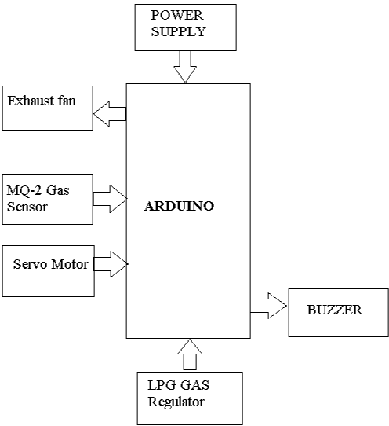
PROPOSED SYSTEM ARCHITECTURE

Slide 15
METHODOLOGY
The methodology of this project adopts a sensor-based embedded system approach to detect LPG gas leaks and respond in real-time using Arduino automation.
The MQ-2 Gas Sensor continuously monitors the air for LPG concentration. When gas levels exceed the safe threshold, the sensor sends a signal to the Arduino Uno.
The Arduino processes this input and activates a buzzer to alert users immediately, ensuring a quick response to hazardous conditions.
Simultaneously, the Arduino controls a servo motor connected to the gas regulator, which turns off the valve automatically to stop the gas supply.
A cooling fan is also triggered via a MOSFET driver to ventilate the area and reduce gas concentration, improving overall safety.

Slide 16
.
Module 1: Gas Leakage Detection and Alert Module
Detects the presence of gas leaks using an LPG gas sensor, which sends real-time data to the Arduino Uno for analysis.
Triggers an alert mechanism using a buzzer when gas concentration exceeds the threshold, ensuring immediate awareness.
Enhances safety by alerting users promptly, helping to prevent accidents due to unnoticed gas leakage.
Offers a simple yet effective method for continuous gas monitoring in domestic environments.
Acts as the first layer of defense in the smart gas safety system.
.
.
.
.

Slide 17
.
Module 2: Auto Cut-off Regulator Activation Module
Automatically shuts off the gas supply using a servo motor.It activates immediately when a gas leak is detected.
The Arduino sends a signal to rotate the regulator to the OFF position.This stops the gas flow from the cylinder at the source.
It prevents further gas leakage and reduces potential fire hazards.The system reacts instantly to eliminate risks.
Ensures a quick and accurate mechanical response.This guarantees maximum safety during emergencies.
It acts as a fail-safe mechanism integrated with the alert system.Both systems work together to ensure full protection.
.
.
.
.

Slide 18
.
Module 3: Ventilation System Activation Module
Activates an exhaust fan when gas leakage is identified.This is done through a relay module controlled by the Arduino.
Helps dissipate leaked gas from the area efficiently.It minimizes gas concentration and the risk of inhalation.
Reduces the chances of accidental ignition.It also improves airflow and ventilation in the environment.
Works automatically with the gas detection unit.this synchronization ensures an immediate response.
Adds another essential safety layer to the system.It keeps the kitchen or storage area safe and breathable.
.
.
.
.
.

Slide 19
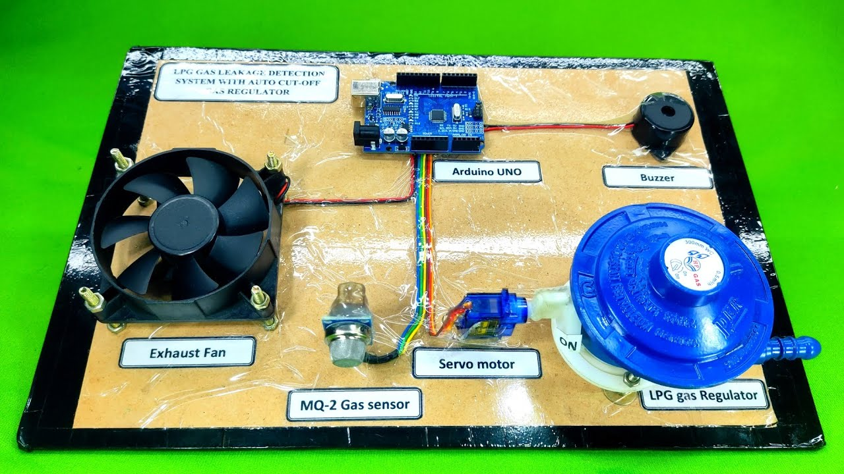
OUTPUT

Slide 20
PERFORMANCE ANALYSIS
The proposed Arduino-based LPG leakage detection system shows significant improvement in detection accuracy and response time compared to traditional manual systems.
Gas sensors integrated with automatic shut-off mechanism ensure immediate response to leakage, reducing hazard risks.
Evaluated based on key metrics: leak detection time, automatic shut-off speed, user alert efficiency, ventilation activation, and system reliability.
Results validate the system's effectiveness as a safe, fast, and user-friendly solution for household and industrial gas safety.

Slide 21
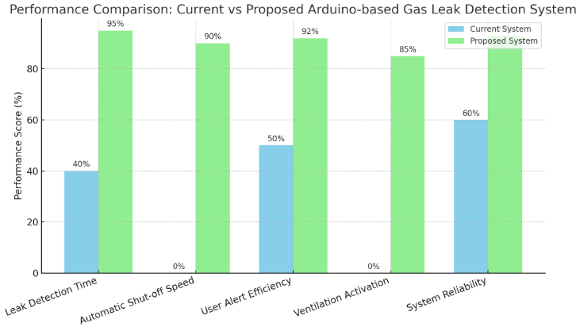
PERFORMANCE ANALYSIS

Slide 22
CONCLUSION
The proposed Arduino-based LPG gas leakage detection system effectively enhances safety by detecting leaks and automatically shutting off the gas supply.
The system integrates an MQ-2 gas sensor and solenoid valve to provide a rapid and reliable response, minimizing potential hazards.
By preventing gas-related accidents, this solution ensures a safer environment for homes and industries while being cost-effective and easy to implement.
The research contributes to improving gas safety standards through automation, reducing risks associated with manual monitoring.

Slide 23
FUTURE WORKS
Enhanced Sensor Accuracy: Upgrading to a more sensitive and selective gas sensor, such as an MQ-2 or MEMS-based sensor, can improve leak detection accuracy and reduce false alarms.
Automatic Shut-off Optimization: Enhancing the servo motor control with a stepper motor or solenoid valve for more precise and reliable gas supply cutoff, reducing the risk of accidental failures.
Power Efficiency Improvements: Integrating low-power components and optimizing the Arduino code to reduce energy consumption, making the system more suitable for long-term use.

Slide 24
REFERENCES
1.
Ashwini D.S, Rohith Naidu (2021). “Smart LPG Gas Level Detection and Safety System using IoT ” International Journal of Engineering Research & Technology (IJERT), 8(13), 2278-0181.
Ankit Sood,Bablu Sonkar, Atul Ranjan, Ameer Faisal (2015). “Microcontroller Based LPG Gas Leakage Detector using GSM Module, International Journal of Electrical and Electronics Research (IJEER), 3(2), 264-269.
Bany Salameh H. A, M. F. Dhainat & E. Benkhelifa (2021). "An End-to End Early Warning System Based on Wireless Sensor Network for Gas Leakage Detection in Industrial Facilities," in IEEE Systems Journal, 15(4), 5135-5143.
Bhagyashree Dharaskar, & Alkesh Gaigawali. (2023). “LPG Gas Leakage Detection and Alert System.” International Journal for Research in Applied Science & Engineering Technology (IJRASET), 11(4), 2321-9653.
Bhavsar, P., & Patel, J. (2020). "Arduino-based Gas Detection System with Automatic Shut-off for Home Safety." International Journal of Electronics, Electrical and Computational System (IJEECS), 8 (5),76-81.
Dave Ryan ,.L, Ferdinand Jamora. D, (2025). “Design and Development of LPG Monitoring and Leakage Detection System.” International Journal of Advanced Research in Science, Communication and Technology (IJARSCT), 5(1), 2581-9429.
Jamadagni . K, P. Sankpal, S. Patil, N. Chougule and S. Gurav (2019), "Gas Leakage and Fire Detection using Raspberry Pi," 2019 3rd International Conference on Computing Methodologies and Communication (ICCMC),495-497, Doi: 10.1109/ICCMC.2019.8819678.
Jebamalar Leavline, E., Deepika, H. (2017). “LPG Gas Leakage Detection and Alert System.”International Journal of Electronics Engineering Research (IJEER), 9(7), 1095-1097.
Manish Raina, & Neeraj Chambyal. (2021).“LPG Gas Leakage Detection using IoT.” International Journal of Scientific Research in Computer Science, Engineering and Information Technology(IJSRCSEIT), 7( 4), 520-526.
Milind Patwardhan, Ruchita Kamble (2023). “LPG Gas Leakage Detector ” International Journal for Research in Applied Science & Engineering Technology (IJRASET), 11(6), 1955-1958.
Park, J., & Lee, D. (2018)."IoT-Based Hazardous Gas Monitoring and Alerting System" IEEE Sensors Journal, 18(22), 9403-9410.
Pravalika, V., & Rajendra Prasad, .C (2019). “Internet of things based home monitoring and device control using Esp32”. International Journal of Recent Technology and Engineering,(IJRTE), 8( 4):58–62.
Salhi,.L, T. Silverston, T. Yamazaki and T Miyoshi (2019) "Early Detection System for Gas Leakage and Fire in Smart Home Using Machine Learning", IEEE International Conference on Consumer Electronics (ICCE), pp. 1-6A.
Sayali Joshi, & Uma Karanje. (2019). “Gas Leakage Detection and Alert System using IoT.” International Journal of Scientific Research in Science and Technology (IJSRST), 6( 2), 2395-6011.
Sarika K Shinde, Priya R Khore, (2020). "Automatic LPG cylinder booking and leakage detection using Arduino UNO" International Journal of Scientific Research in Science, Engineering and Technology (IJSRSET), 7(3), 418-423.
2.
3.
4.
5.
6.
7.
8.
9.
10.
11.
12.
13.
14.
15.

Slide 25
THANK YOU

